Slide 1
Preapprovals & Mortgages

Slide 2
Role of a Mortgage Broker
Independent of any Bank or Lender
Access to Different Rate & Product Options
Limited Credit Inquiries
Coordinate with Realtor, Lawyer, and Home Inspector
Advice for Lower Costs - Now & Later
No Cost to You!

Slide 3
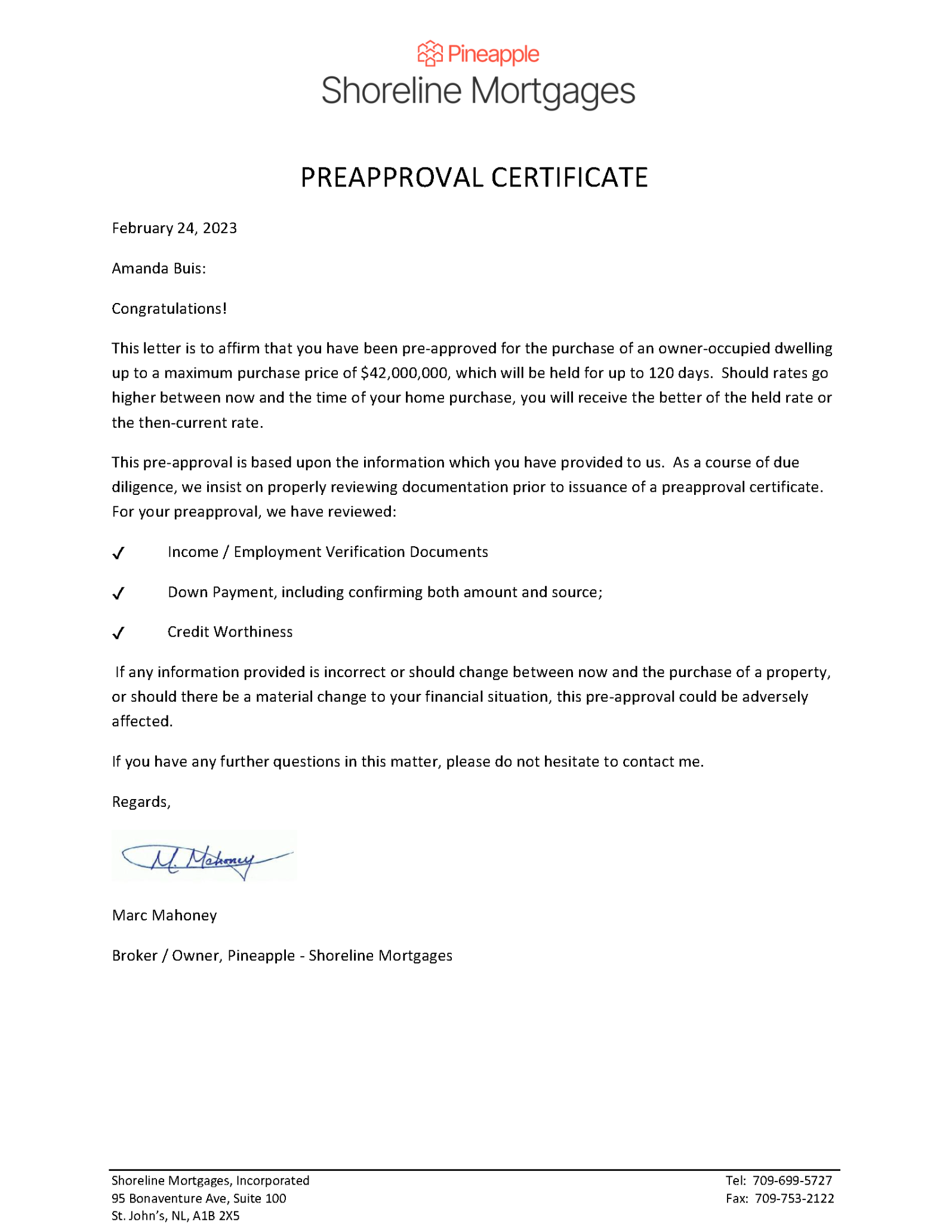
Preapprovals
Documents Required
Income
Employed
Employment Letter
Paystub
T4’s
Self Employed
T1 Generals
Notices of Assessment
Down Payment
Savings (Chq Accts, TFSA, FHSA)
RRSPs
Gifted or Borrowed
Closing Costs & Property Taxes
Completed Electronically

Slide 4
Medical Student/Resident Considerations
Stipulated income - 10% down
Medical Student LOC
* can be used for down payment - flex down - interest rate premium
* balance added to debt servicing ratio - 3% or amortized
Example: $100,000 owing
3% = $3000/month OR
amortized, 5.25% over 25 years = $595.92/month
Co-signor option - family member

Slide 5
Purchase Plus Improvements
How Does it Work?
What do I do to Apply?
When Do I Get the Money?
What Improvements Qualify?

Slide 6
Scenario:
$300,000 Mortgage
4.54% Fixed Rate or 5.75% Adjustable Rate
Break Mortgage in Two Years
Variable & 5 Year Decrease 1.00%
3 Year Decrease 1.50%
Mortgage Prepayment Penalties
Type | Fixed, “Big 5” *Scotiabank | Fixed, Preferred | Variable or Adjustable
Monthly Payment Penalty | $1667.10 $13,500.00 | $1667.10 $4500.00 | $1875.07 $3415.29
All calculations speculation only, based on projection of future rates, with no guarantees of future rate movement.

Slide 7
Fixed?
Variable?
Open?
Closed?
Consider Your Situation
Every situation is different. There isn’t simply one right choice.
Consider Future Plans
Might you sell? Could penalties be triggered?
Consider Risk Tolerance
What is your comfort level? Does it fit your cashflow?

Slide 8
@shoreline.mortgages
Marc & Joanna Mahoney - Pineapple - Shoreline Mortgages & Financial Advisor
@shorelinemortgages
www.shorelinemortgages.com

